Slide 2
VR Art Exhibition
VR
Educational Applications’ Evaluation
Development and Evaluation of Mixed Reality Educational Applications
MR(AR & VR) Chemistry Lab
AR
3D Coloring Game

Slide 3
Mixed Reality (MR)
Real
Environment
Augmented
Reality(AR)
Augmented
Virtuality (AV)
Virtual
Environment
Virtuality Continuum (VC)

Slide 4
Author | Essay topic | Gauge dimensions |  | Applicable people | Gauge features
Alvaro & Babette [] | Rubric for Assessing or Designing Digital Playful Learning Spaces(2001) | 7D | Fantasy space | Decision makers Parents Teachers Businesses Educators Developers | Emphasis is placed on the learning needs of users and less attention is paid to gameplay and entertainment. In the form of questions, it is a qualitative assessment
 |  |  | Feedback
 |  |  | Sense of control
 |  |  | Gamification learning curve
 |  |  | Special needs adaptability
 |  |  | Learning opportunities
 |  |  | Various educational opportunities
British Teacher Evaluation Education Media Organization [] | TEEM Teacher Evaluation Framework (2002) | 6D | Use profile | Teachers | There are a total of 37 questions, each of which must be enlarged with a complete sentence. This evaluation is more rigorous. Focuses on teachers’ teaching applications and is a qualitative assessment
 |  |  | Course relevance
 |  |  | Design and navigation
 |  |  | Ease of use
 |  |  | Recreational
 |  |  | Installation

Slide 5
Author | Essay topic | Gauge dimensions |  | Applicable people | Gauge features
RICAR_DO JAVIER RADEMA CHER MENA | E/E Grid (EDU Grid &ENT Grid) (2010) | 2D | Education (as a specific indicator of the " knowledge" dimension in Gardner's Multiple Intelligences and the 2001 Anderson Educational Target Classification) | Game designer Teacher Educator | full account of the balance between educational and gameplay, using Caillois's game type classification is not very suitable for the types of games in modern educational games, and it is a qualitative evaluation.
 |  |  | Gameplay (as a specific indicator of the Battle virtual world player type and Caillois game type)
Wang Wei[37] | Multi-intelligence-based electronic game education comprehensive evaluation index system（2009） | 3D | Tasks | Teacher User Educational game development company | 11 task boxes, 27 scene indicators and 25 interaction indicators. The indicators are very subtle and have the right to restate, which helps to evaluate the accuracy of the results. It belongs to quantitative evaluation
 |  |  | Scenes
 |  |  | Interaction

Slide 6
Author | Essay topic | Gauge dimensions |  | Applicable people | Gauge features
LEONAR D A. ANNET_TA, RICHAR DLAMB &MAR_CUS STONE[] | Serious Educational Game Rubric [SEGR] (2011) | 13D | Preface | Teachers, game developers, etc. | The integration of education and playability, using Kappa coefficient to test the various factors of the rating scale, improved reliability and validity. Really combine education games with classroom teaching and student’s psychology characteristics to formulate evaluation indicators, and consider the teaching needs of teachers. Each indicator (0 points, 1 point, 2 points...) is a quantitative evaluation
 |  |  | Tutorial
 |  |  | Interaction
 |  |  | Feedback
 |  |  | Identity
 |  |  | Happy / depressed
 |  |  | Sense of control
 |  |  | Degree of difficulty
 |  |  | Rule
 |  |  | Learning Content
 |  |  | learning target
 |  |  | Teaching effect
 |  |  | Communication channel

Slide 7
Identification picture turn green; Call delay function
Identification picture is stable in the scan box
Pass the screenshot to the material of the object as a texture; Pass the parameters to Shader
Y
Y
Scan the identification picture with camera
Identification picture is in the scan box
N
Stop the delay function
N
Identification picture turn red

Slide 8
Identification map turn green; Call delay function
Click the Earth
The Earth rotate
Y
Scan the identification map with camera
Identification map is in the scan box
Click the Earth
Show the Solar system
N
Identification map turn red

Slide 9
a
c
e
b
d
r
g
h

Slide 10
targetAnglePoint1
（-X/2,Y/2,0）
targetAnglePoint3
（X/2,Y/2,0）
P_Point1
P_Point3
（0,0,0）
P_Point2
P_Point4
targetAnglePoint2
（-X/2,-Y/2,0）
targetAnglePoint4
（X/2,-Y/2,0）

Slide 11
U_Point1
U_Point3
P_Point1
P_Point3
P_Point2
P_Point4
U_Point2
U_Point4

Slide 12
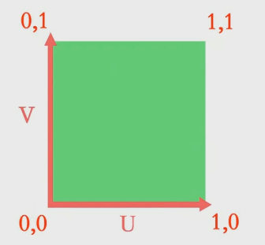
（0,1）
（1,1）
V
（0,0）
U
（1,0）

Slide 13
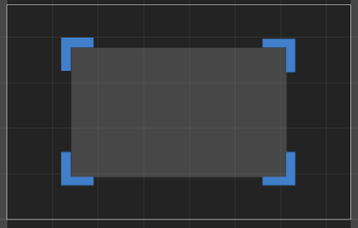
（0，600）
（800，600）
Y
（800，0）
（0，0）
X

Slide 14
Scan the identification map1 with camera
Color the identification map2
Scan the identification map2 with camera
Show the 3D model

Slide 15

Success

Slide 16
AR 显示
识别图制作
获取屏幕截图
将获取的贴图贴到模型上
Vuforia 网站上传识别图，然后下载包导入Unity3d
UV 拆分和匹配
显示模型制作
贴图坐标计算
Shader 值传递
Photoshop
Maya/3D max
Unity 3D
Mobile Devices

Slide 17
Upload the target pics to Vuforia site and download and import the Unity package to Unity3d
AR display
Target pic production
Get the Screen capture
Attach the captured map to the model
UV Split and match
Model producion
Mapping coordinates
Pass the Shader value
Photoshop
Maya/3D max
Unity 3D
Mobile Devices

Slide 18
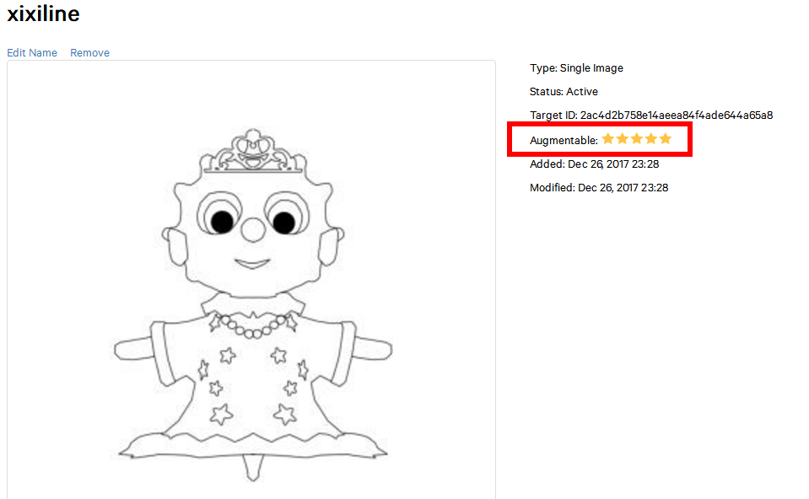
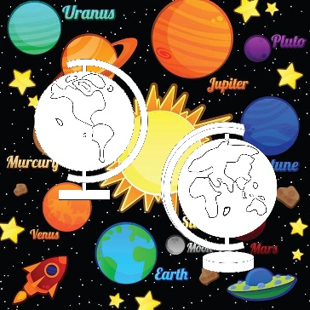

Slide 19
